Slide 1
The Game Engine of the Future

Slide 2
Why am I here?

Slide 3
Say anything you want.

Slide 4
It’s all about the data.

Slide 5
@Insomniac: Creating something new.

Slide 6
Radical changes.

Slide 7
Shared my personal vision with team.

Slide 8
What do I believe?

Slide 9
Games are Important.

Slide 10
For the money?

Slide 11
For the fame?

Slide 12
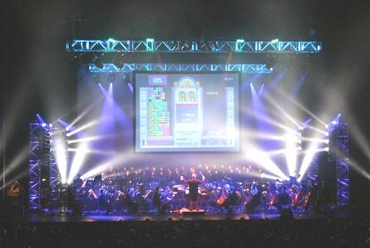
For the fame?

Slide 13
For the girls?

Slide 14

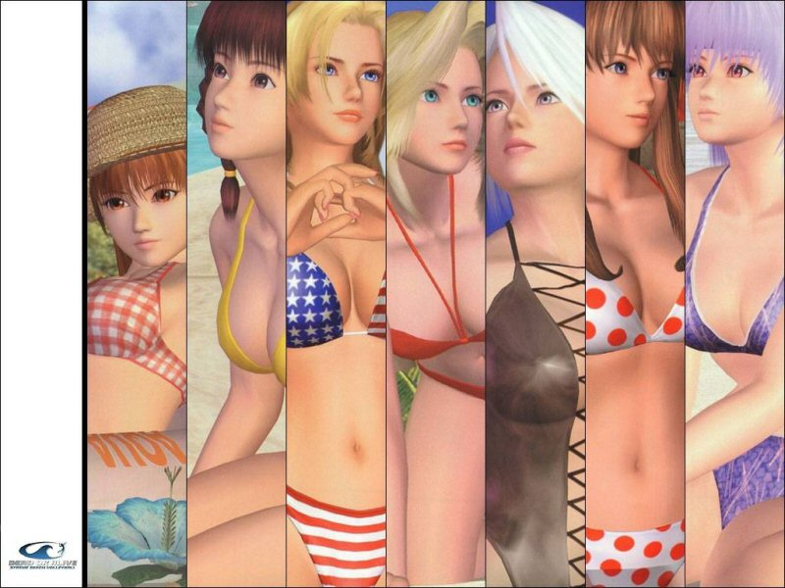
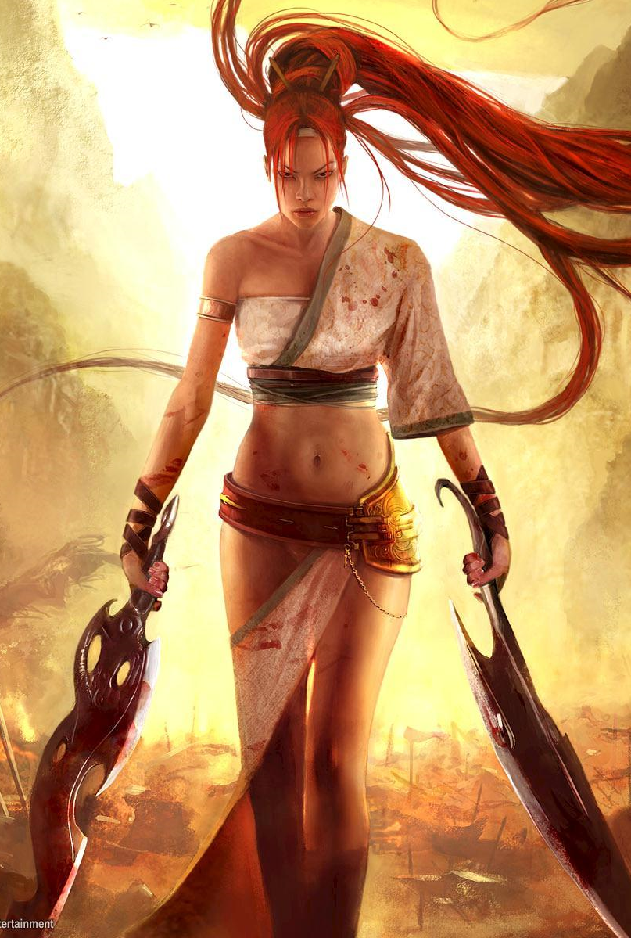
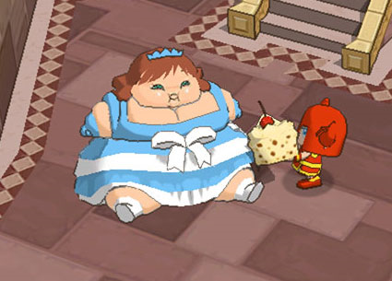
For the girls?

Slide 15
Creation Ego?

Slide 16









Creation Ego?

Slide 17
Games make a difference.

Slide 18
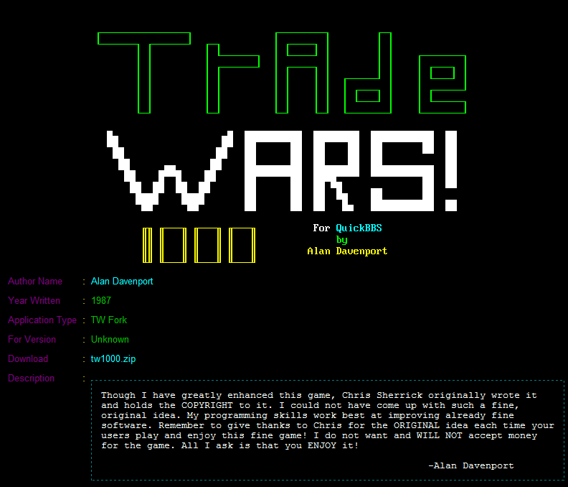

Slide 19




Slide 20


Slide 21
Games are Pop

Slide 22


Slide 23
Games are Art

Slide 24
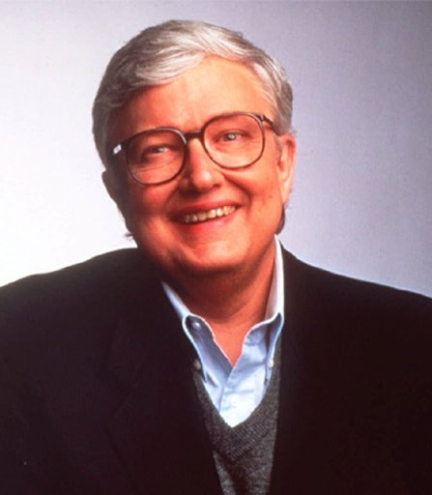

Slide 25
Full of Shit*
*About video games

Slide 26
Participatory Fantasy

Slide 27
Augmented Dreams

Slide 28
Interactive Creativity

Slide 29
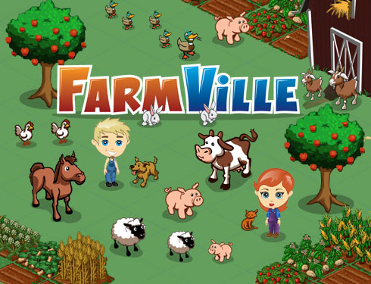
OCD Release

Slide 30
Game development gives me a chance to give back.

Slide 31
Why does it matter what I believe?

Slide 32
Defined me and what I do.

Slide 33
Playing -> Trading -> Making

Slide 34
Inspires me to do it.

Slide 35
“So we need some standardization for data interchange among development tools and products. The more developers that adopt a standard, the better for all of us and our customers.”
-- Jerry Morrison, EA IFF 85

Slide 36
"Simple things should be simple and complex things should be possible."
-- Alan Kay

